Slide 1
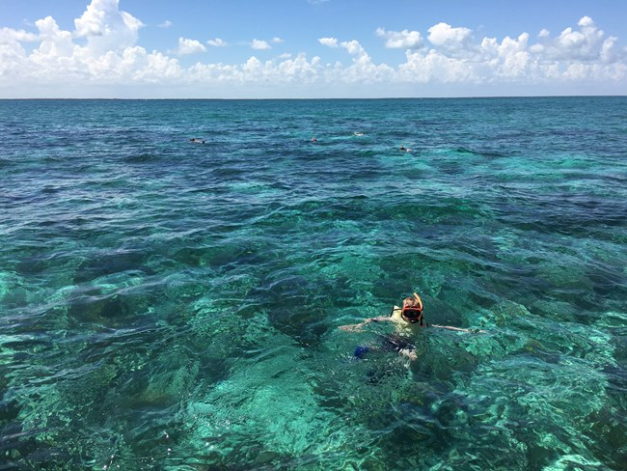
Biscayne Bay Restoration Initiative
T. Spencer Crowley III
Miami Dade County Commissioner to the
Florida Inland Navigation District

Slide 2
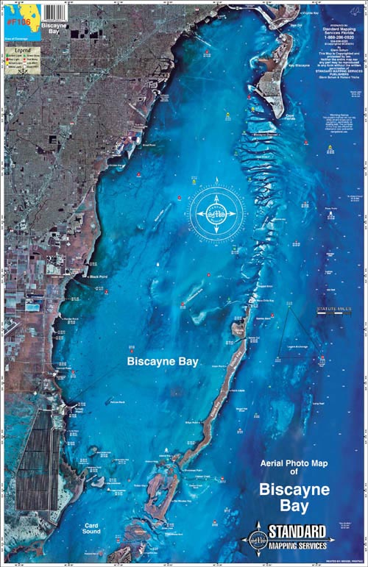
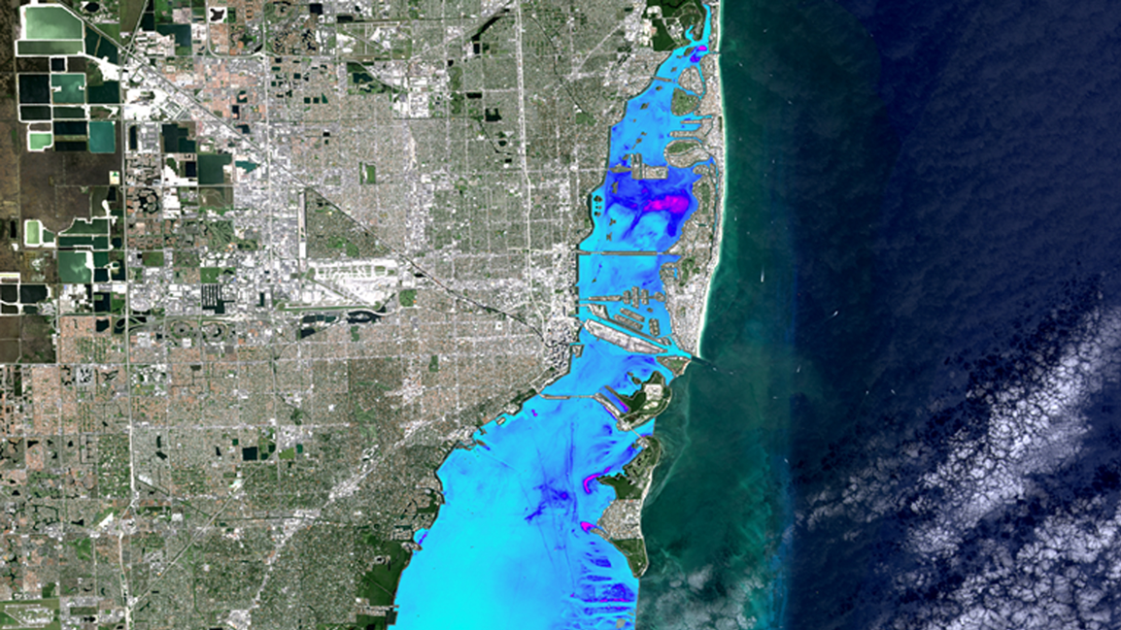
Biscayne Bay

Slide 3
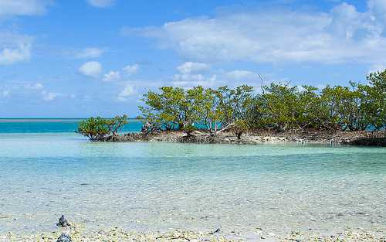
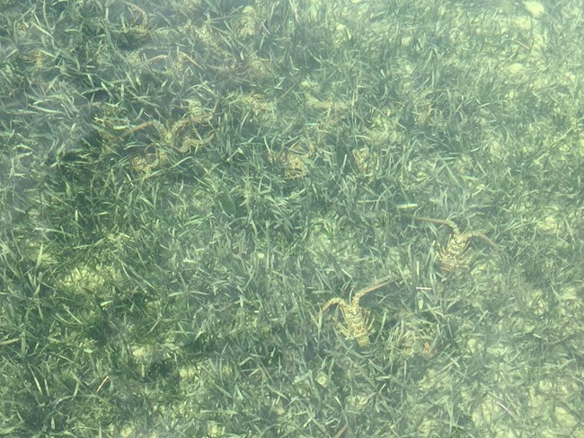
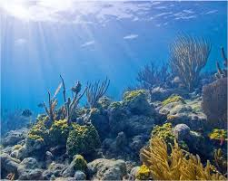
Healthy Biscayne Bay

Slide 4
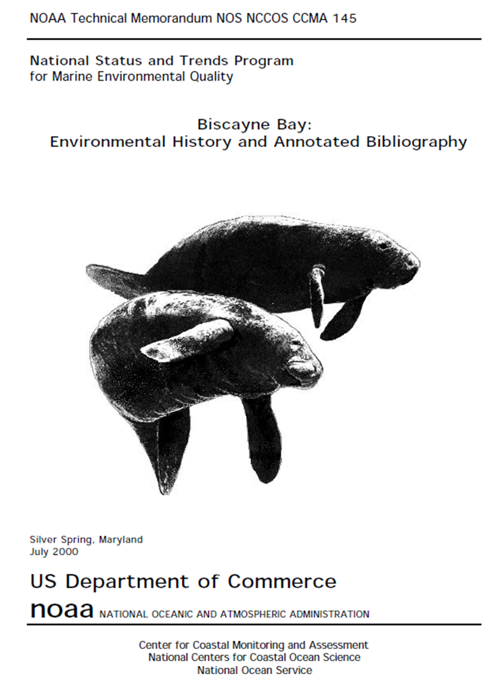
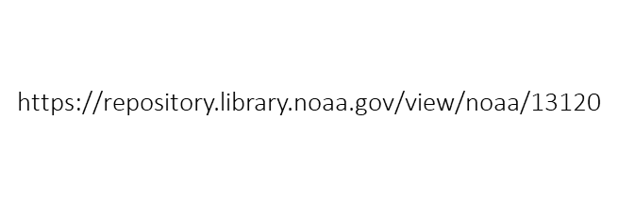
Biscayne Bay Regulation
1974 – BBAP Established
1975 – BBAP Expanded South
1980 – BNP Established
1981 – DERM Biscayne Bay Management Plan
1985 – DERM Biscayne Bay Restoration and Enhancement Program
1999 – BBPI Established and Convenes
2001 – BBRRCT Established
2013 – FDEP BBAP Management Plan

Slide 5
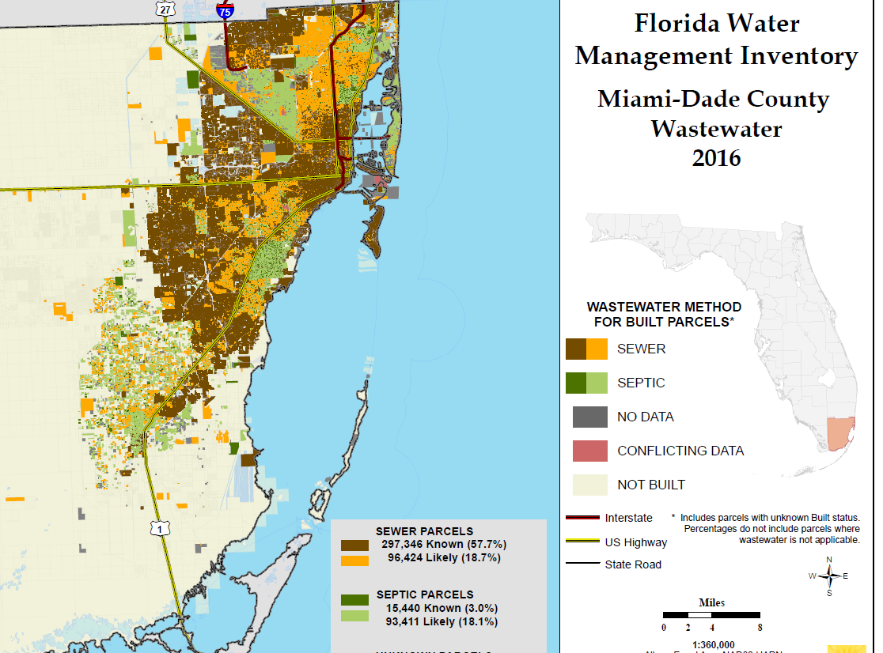
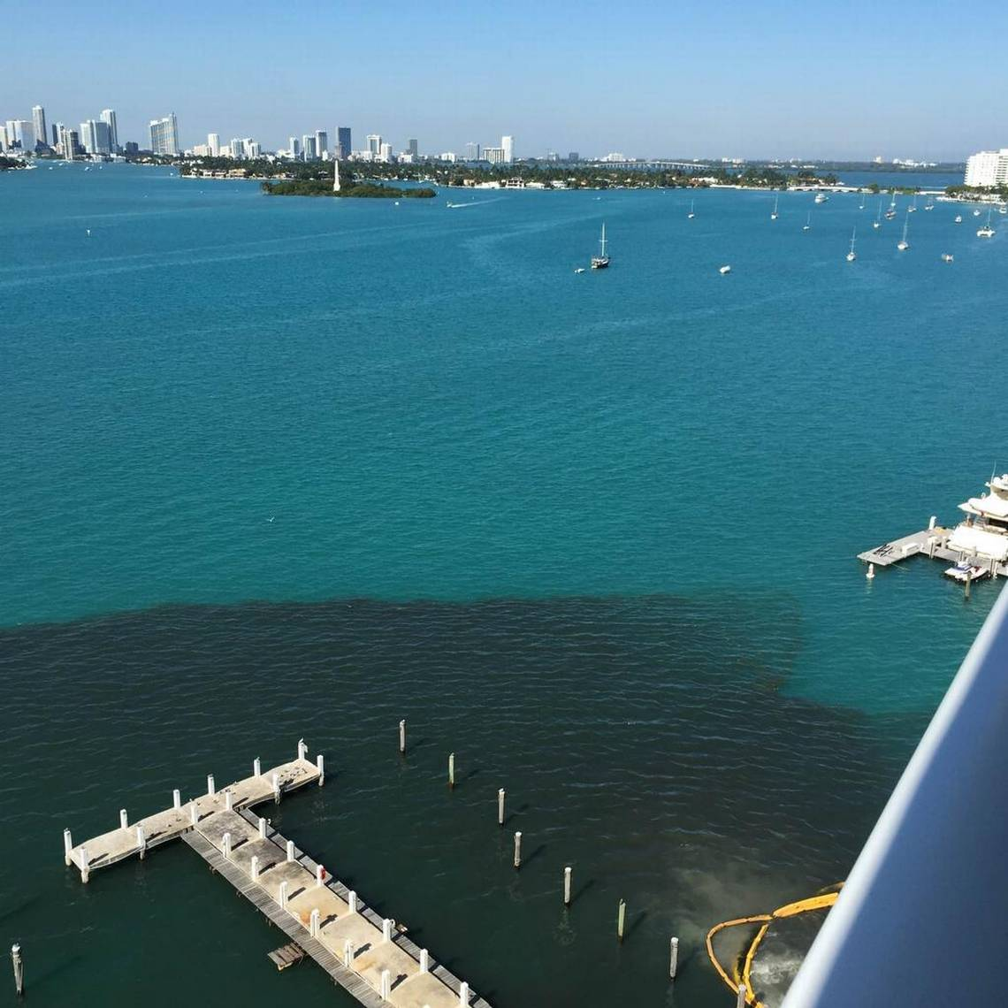
Regulation ≠ Health or Restoration

Slide 6
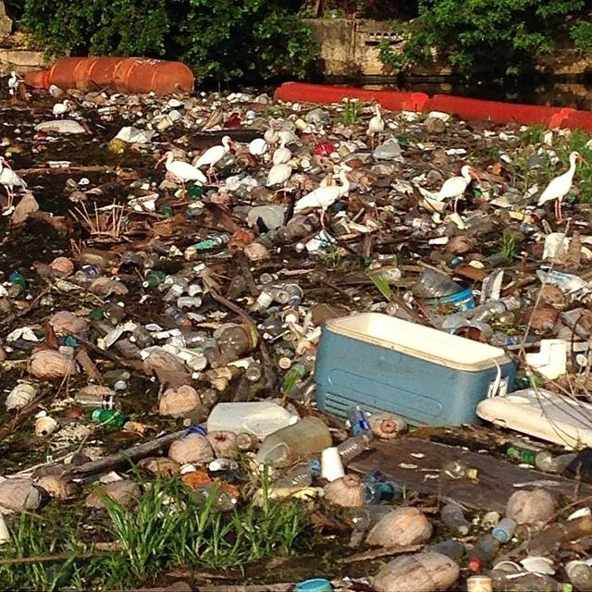
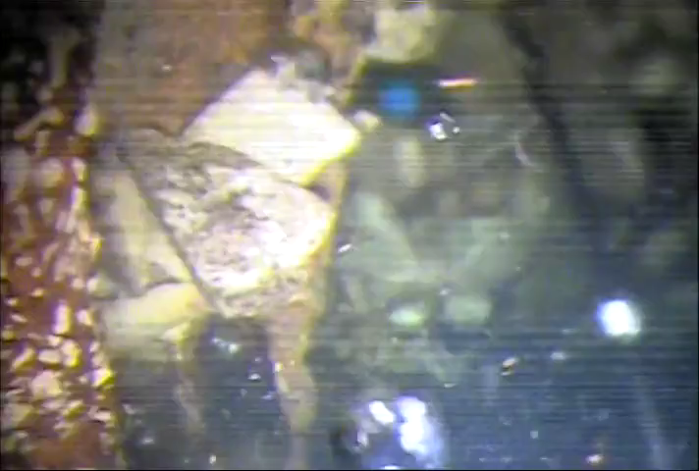
Storm Drains – Solid Waste

Slide 7

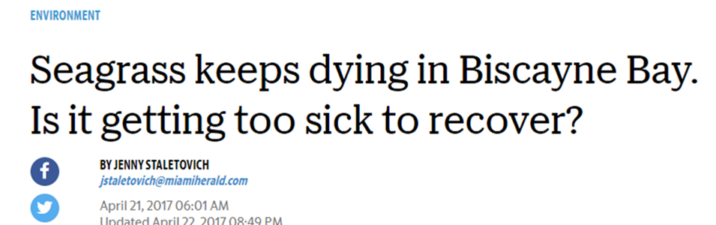
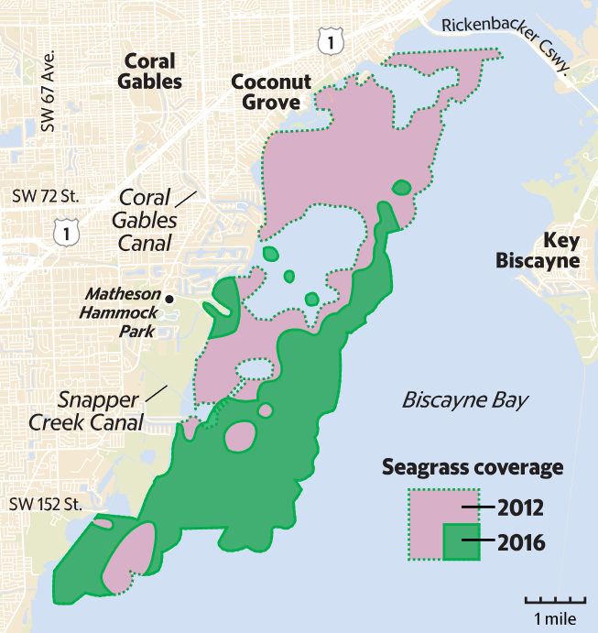
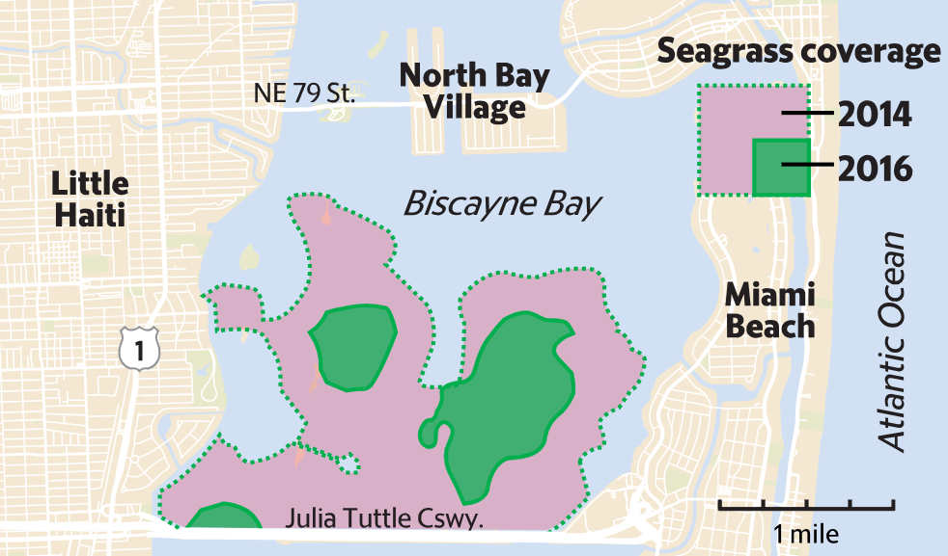
Seagrass Problems

Slide 8
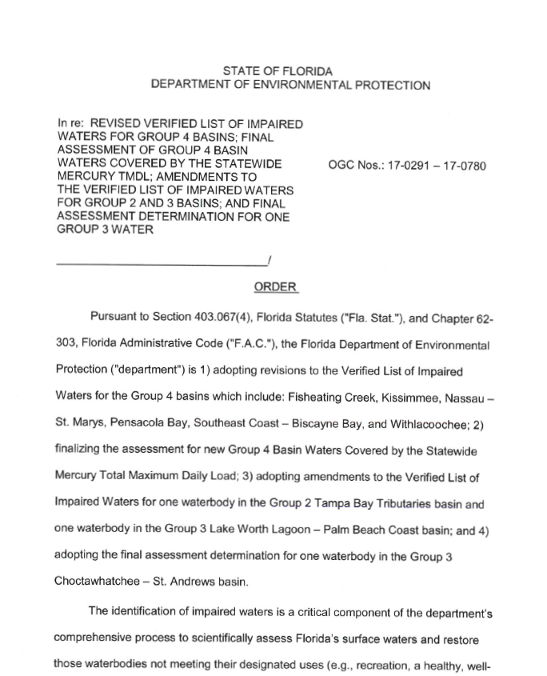
Biscayne Bay –
Impaired Waterbody
2017 – FDEP determines that Biscayne Bay is an “impaired waterbody” because of Chlorophyll-a, Nitrogen

Slide 9
What do we do?
Central Florida Water Initiative
Indian River Lagoon Council - National Estuary Program
Charlotte Harbor National Estuary Program
Loxahatchee River
Chesapeake Bay
Lake Worth Lagoon in Palm Beach County

Slide 10
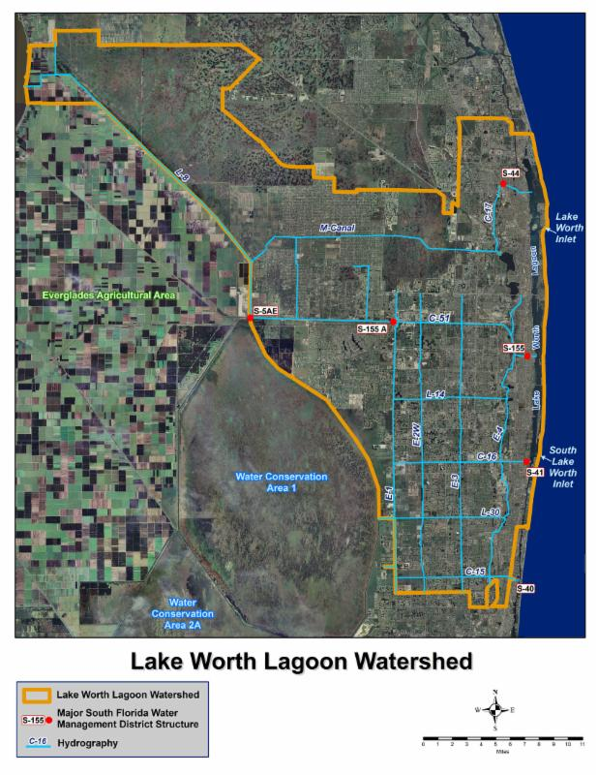
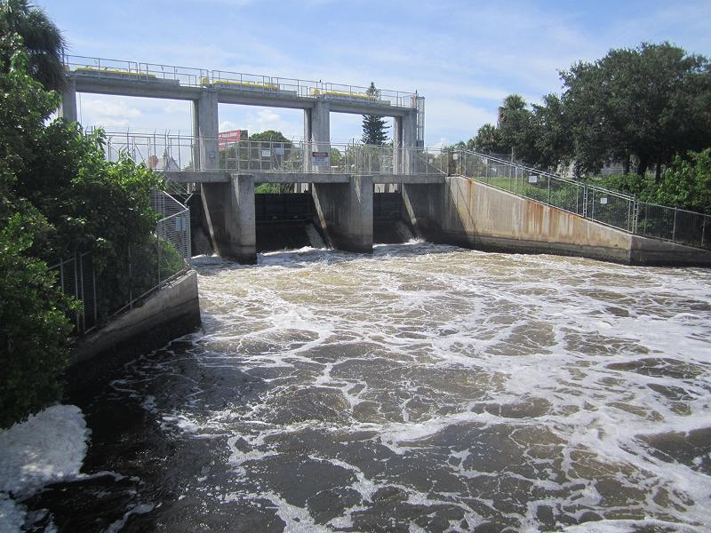
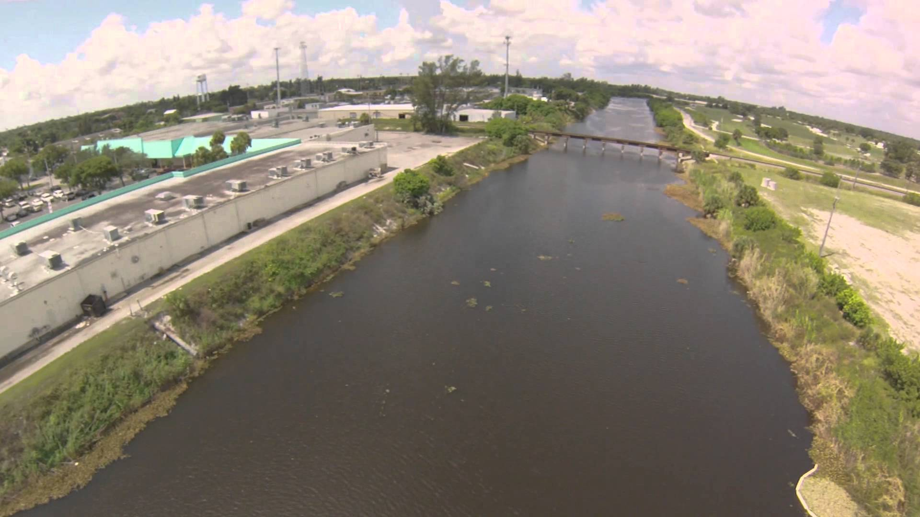
Lake Worth Lagoon - Sister “Estuary”

Slide 11

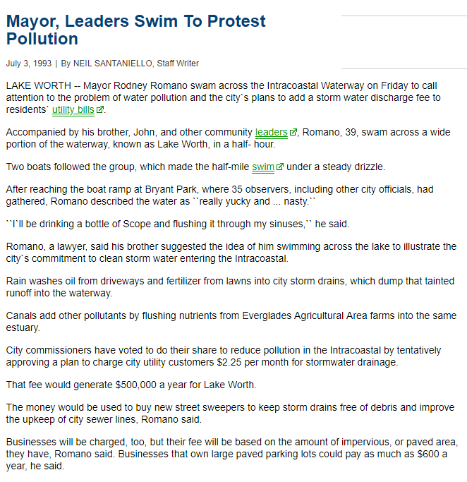
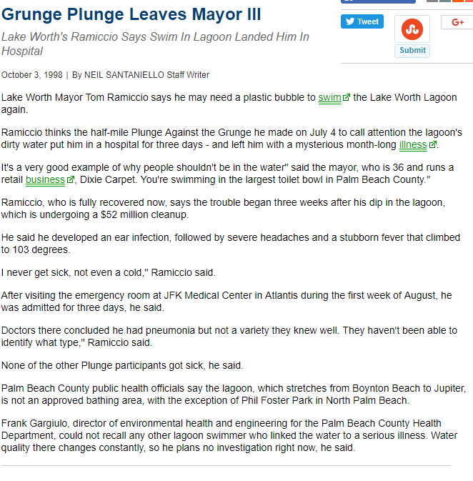

Slide 12



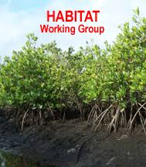


Slide 13
Steering Committee
The LWLI Legislative Funding Request will be open from May 11, 2018 – August 3, 2018. Applications must be submitted by August 3, 2018.
Applicants will be expected to provide the Committee a ten (10) minute presentation outlining the merits of the proposed project on August 16, 2018.
The Committee will rank the selected projects by a formal vote. A final project list and ranking will be announced at the Lake Worth Lagoon Initiative Steering Committee meeting on September 19, 2018.
The ranked project list will be recommended to the Palm Beach County Board of County Commissioners for inclusion into its annual legislative agenda.
Each LWLI member entity is also encouraged to adopt and support the LWLI legislative funding request.
Funding becomes available July 1, 2019.

Slide 14
Working Groups
Water
Habitat
Public Outreach

Slide 15
Water Working Group
Develop a “Reasonable Assurance Plan” in order to remove Biscayne Bay from State list of impaired waterbodies
Other option - FDEP will establish a Total Maximum Daily Load through a Basin Management Action Plan

Slide 16
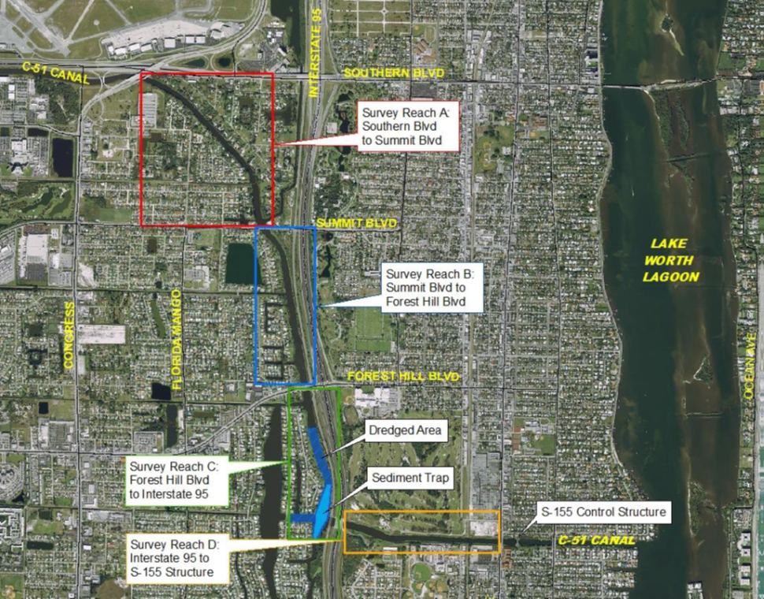
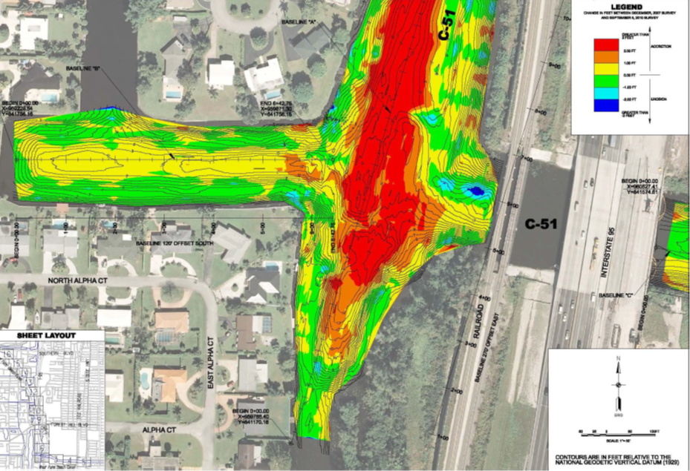
C51 – Sediment Trap

Slide 17
Stormwater Improvements

Slide 18
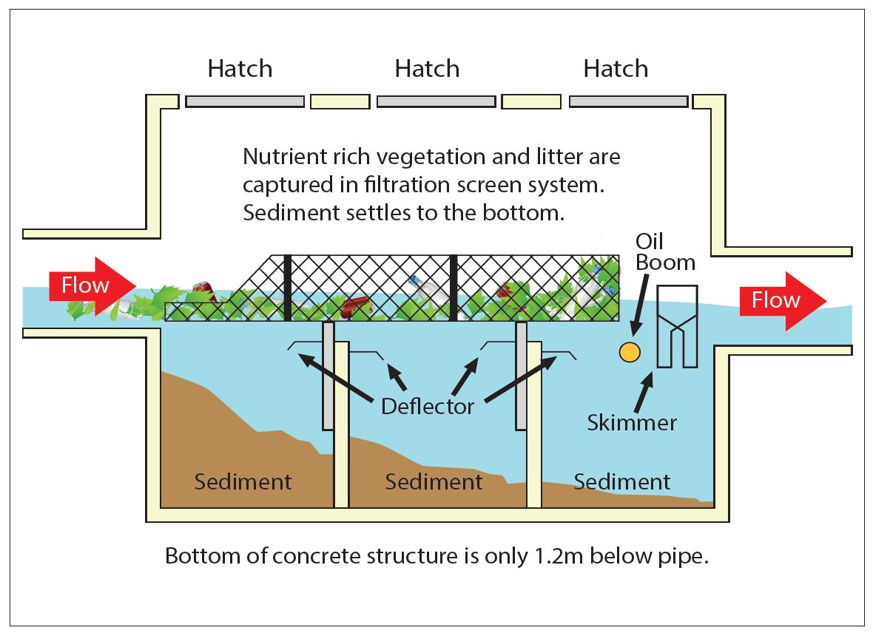

Baffle Boxes at Stormwater Outfalls

Slide 19
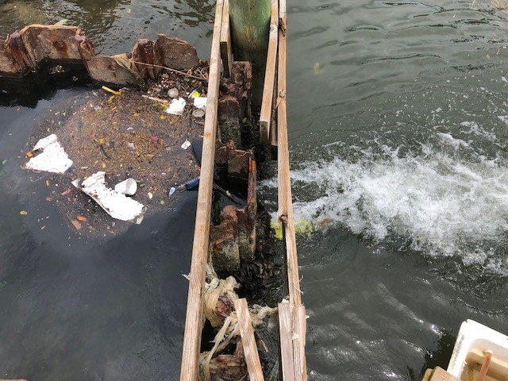
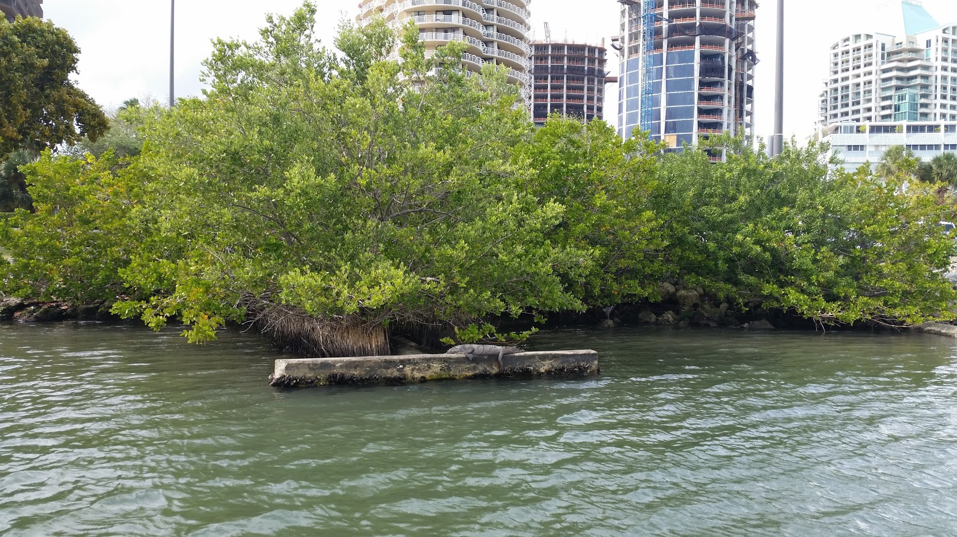
City of Miami Baffle Box

Slide 20
Septic to Sewer Conversions

Slide 21
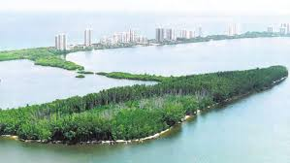
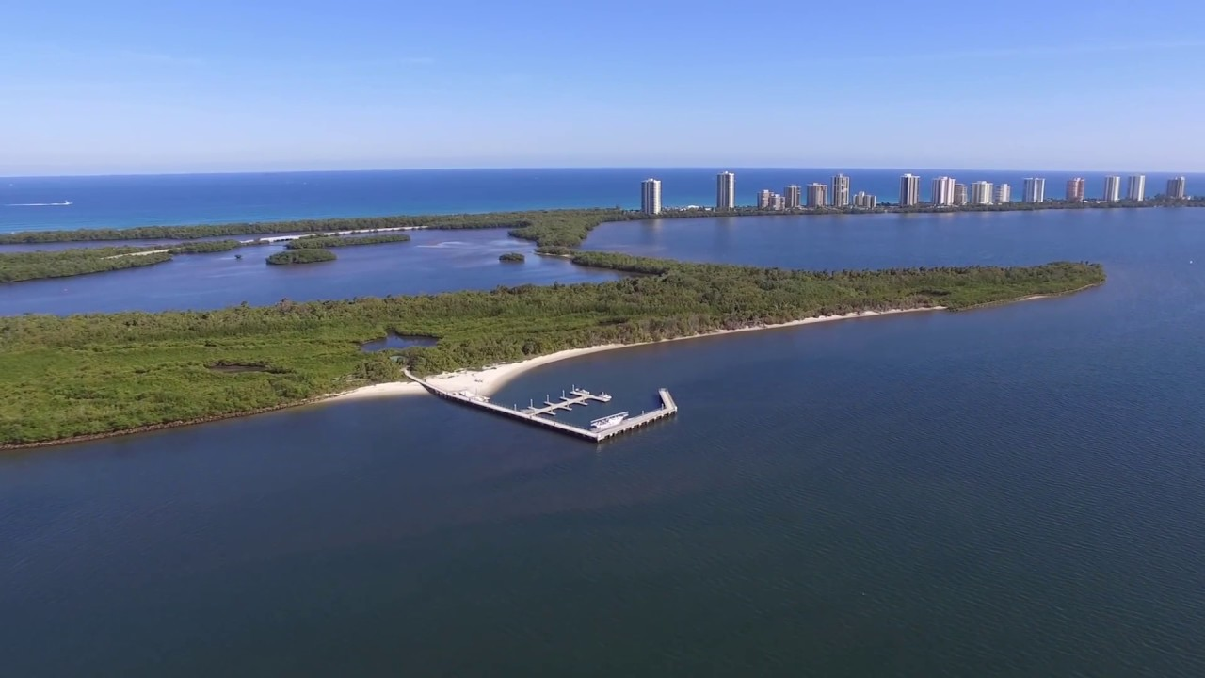
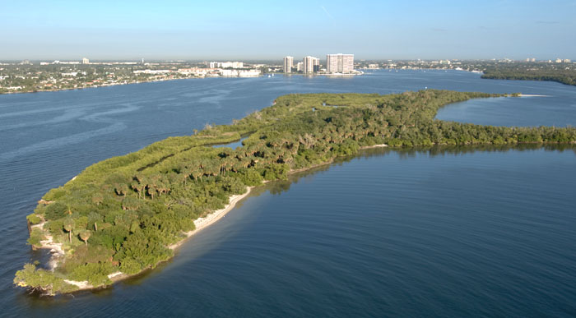
Habitat Working Group

Slide 22
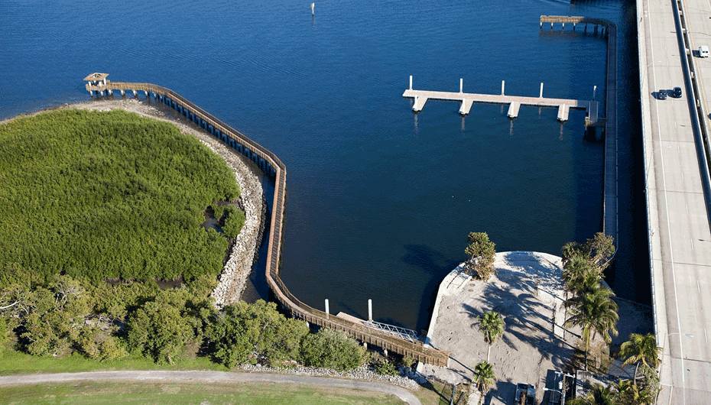
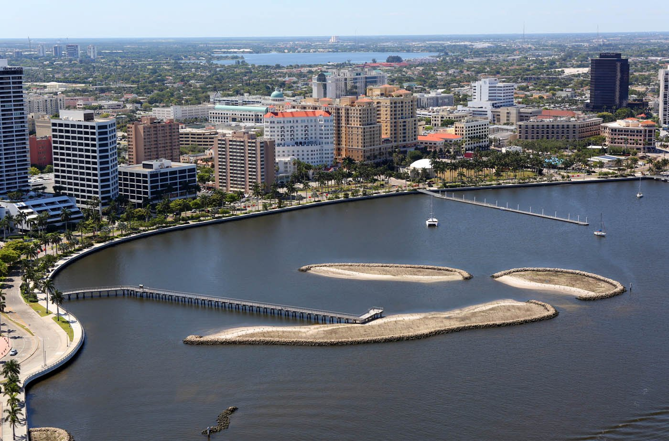
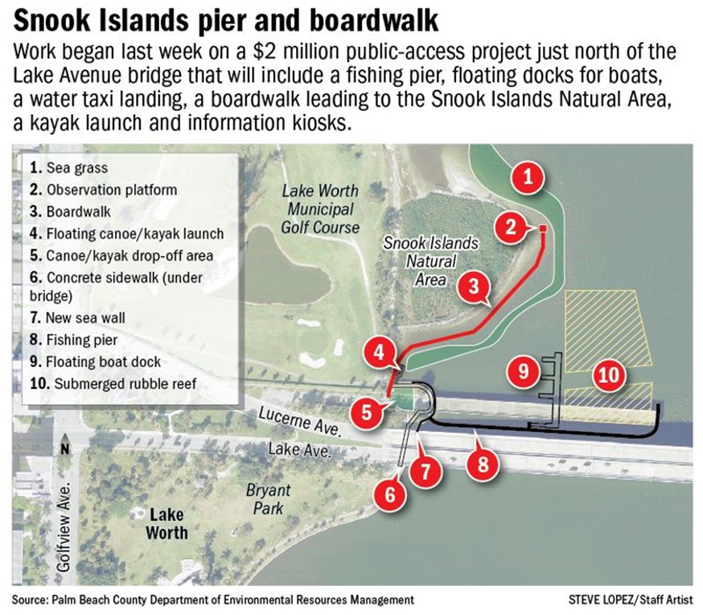
Dredge Holes

Slide 23
Living Shorelines

Slide 24
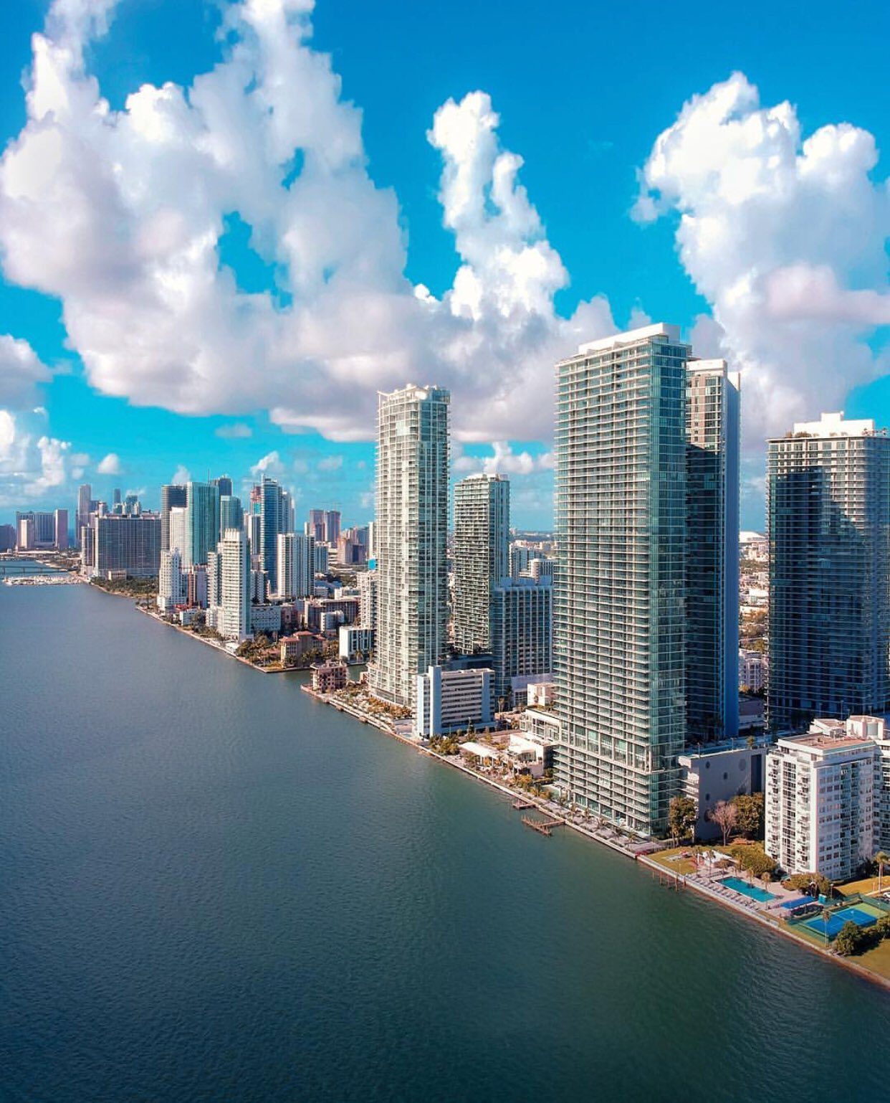
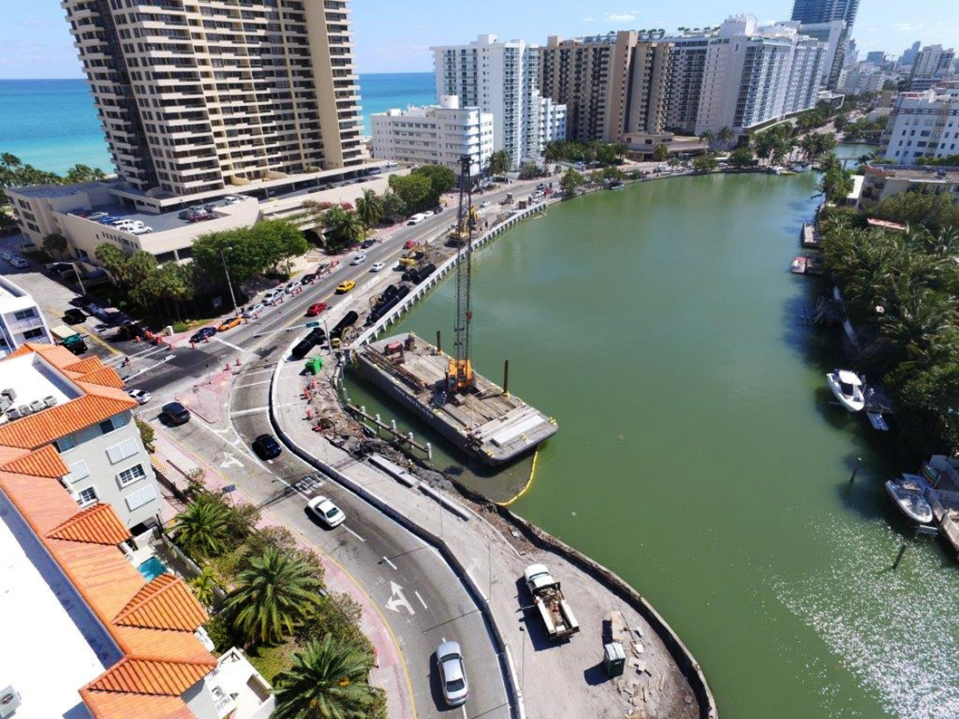
Living Shoreline Opportunities

Slide 25


Public Access and Outreach

Slide 26
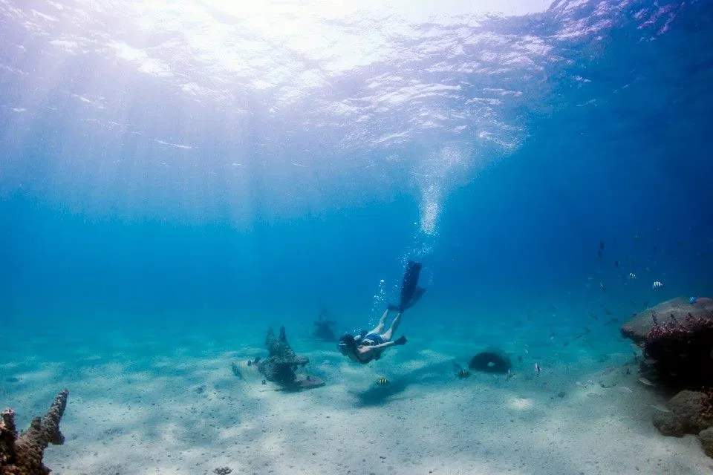
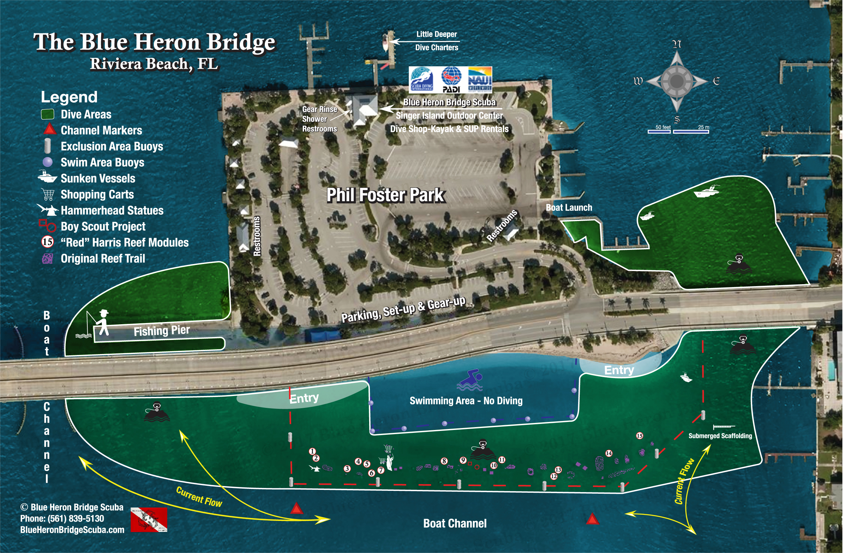
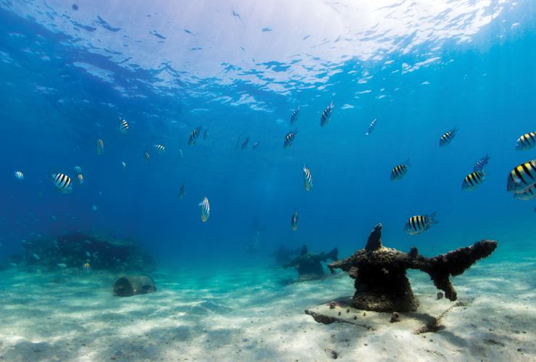
Snorkel Trail

Slide 27


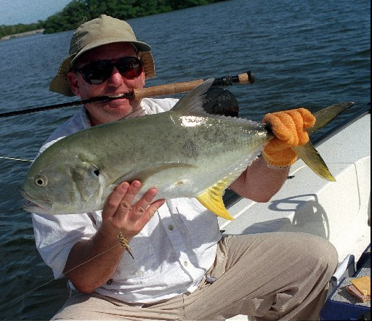
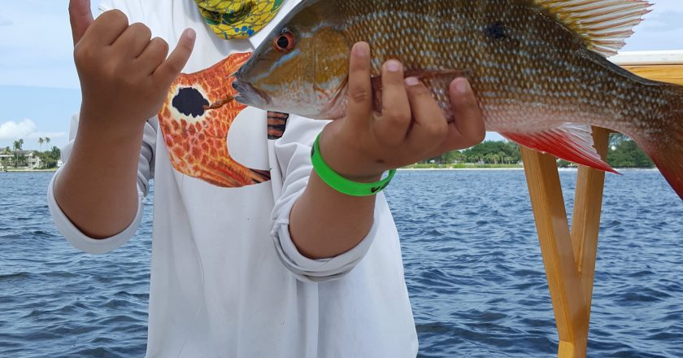
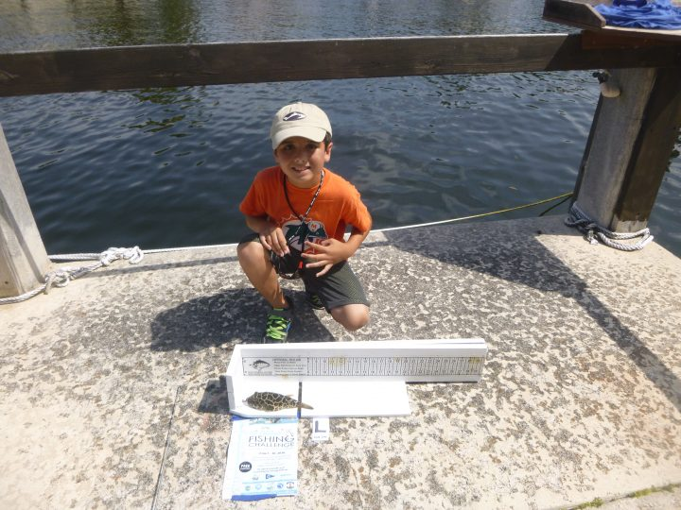

Slide 28
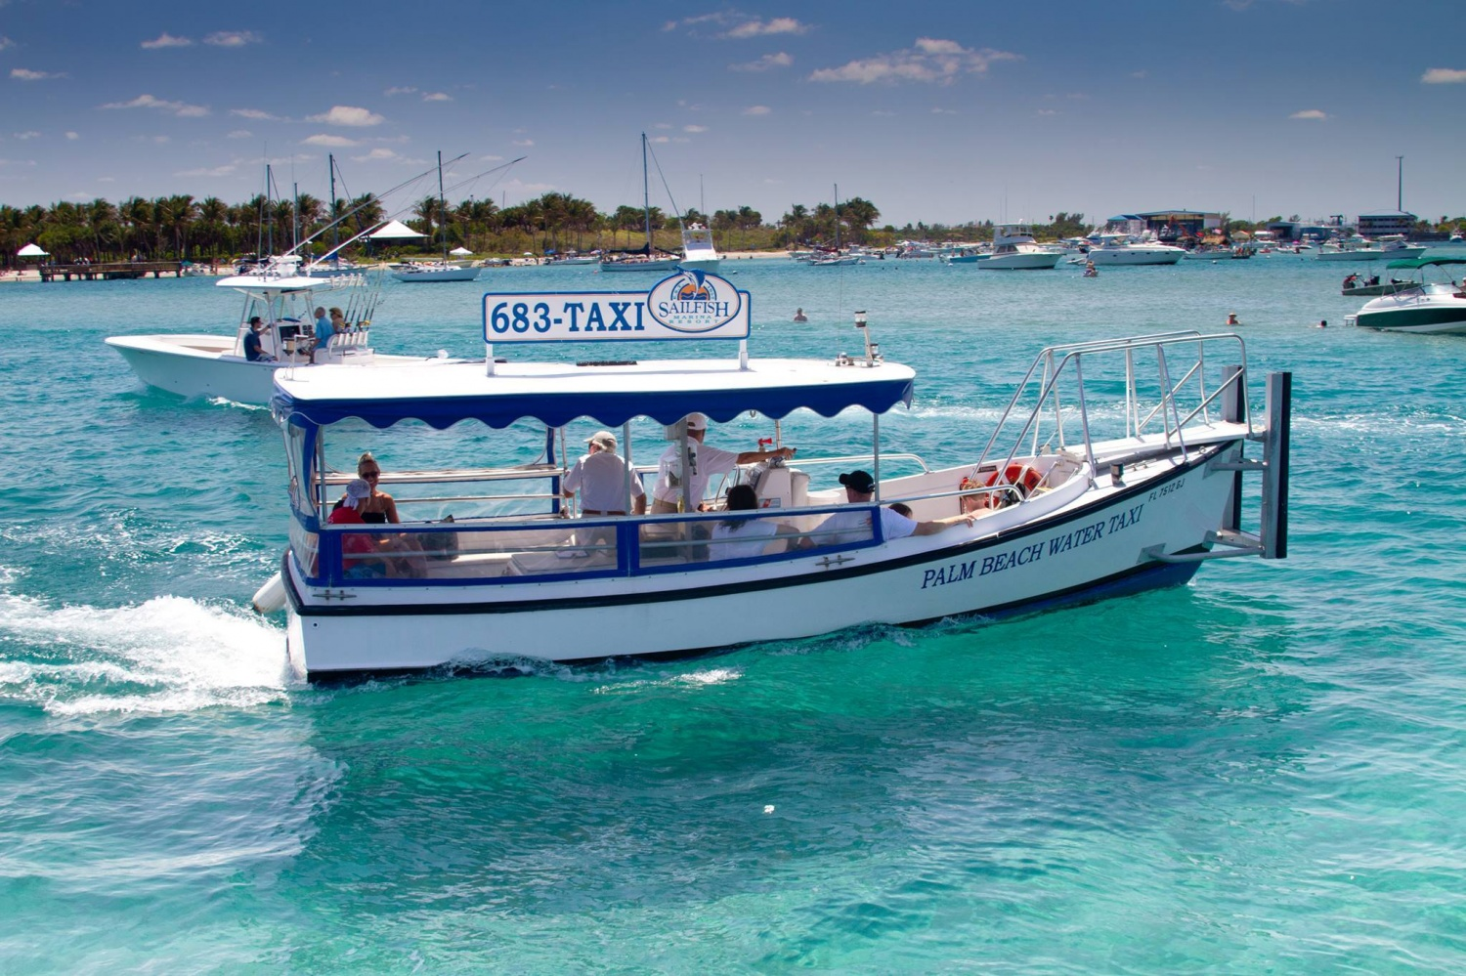
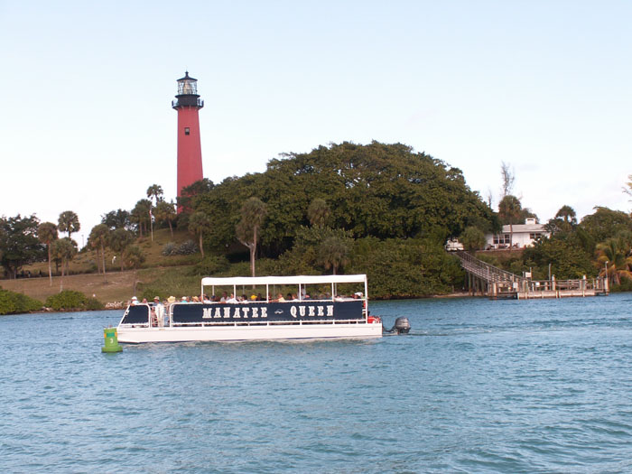
Water Taxis

Slide 29
Biscayne Bay Restoration Initiative - Progress
January 2017 – Letter to Dade delegation
April 2017 Herald article regarding seagrass
May 2017 – SFWMD Chair Fernandez presents to BBYC
May 2017 – Meetings with DERM
Summer 2017 – Meetings with stakeholders – Waterkeepers, MRC, Captain Dan, DERM, Levine-Cava
July 2017 – Biscayne Bay Marine Health Summit
September 2017 – legislation creating BBRI drafted
November 2017 – BB Task Force legislation at Committee
Late 2017/Early 2018 – Discussions with Harvey Ruvin and Stakeholders
Summer 2018 – Reconciliation of Legislation
Fall 2018 – Adoption?

Slide 30
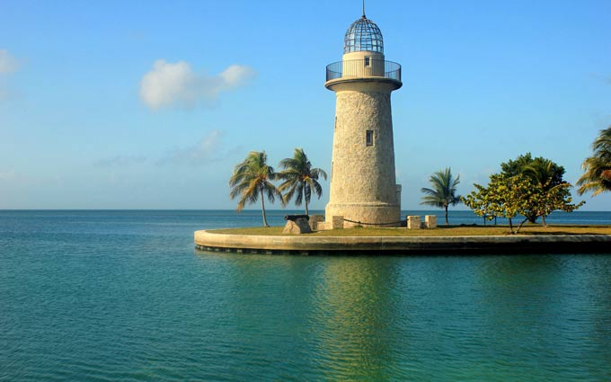
Questions/Discussion?

